Slide 1


Memory Game
Popa Andrei
Avasiloaie Bianca

Slide 2
Table of contents
01
02
03
05
Introduction
Introduction
What is Memory Game?
How to play?
04
06
Introduction
How it works?
Conclusions
Interface

Slide 3

02
Introduction

Slide 4

How we done this project?
Our project was made in Excel APP, using VBA and based on the courses studied in the first week.
Visual Basic for Applications is a computer programming language developed and owned by Microsoft. The VBA programming language allows users to access functions beyond what is available in the MS Office applications. Users can also use VBA to customize applications to meet the specific needs of their business, etc.

Slide 5
02
What is Memory Game?

Slide 6
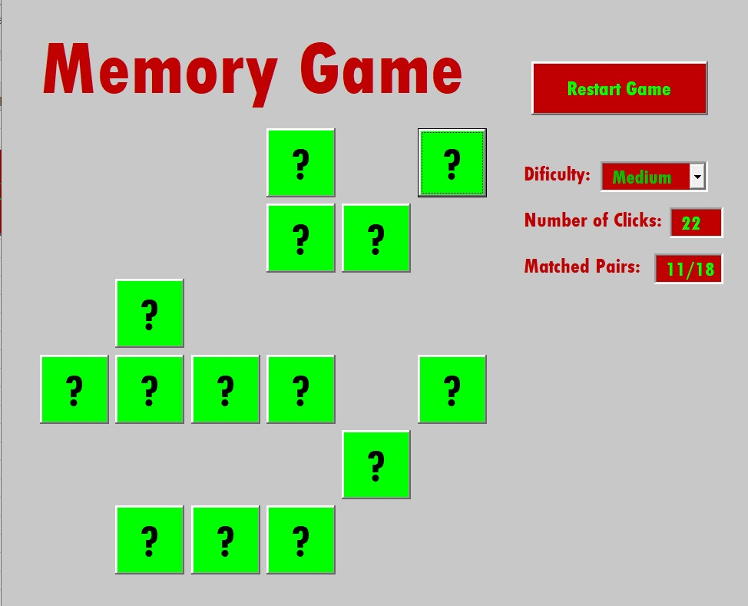
What is Memory Game?
Memory Game is a pair matching game, where you can test your memory and concentration skills. The goal is to remove all the cards from the table by matching them with other same rank cards.
Playing memory games can improve other brain functions, such as attention, concentration, and focus. Memory games can also improve visual recognition.

Slide 7

03
How to play?

Slide 8
Memory Game rules
How to play Memory Game?
The deck consists of 8/18/32 different pairs of cards, labelled 1, 2, 3..etc.
Each turn, you flip over two cards(one at a time, so you can see the first one before picking the second).
If the two cards match, then they are removed from the game, otherewise are returned.
The game ends when all the cards are removed, but if you overpassed 60/120/240 clicks, the game will end instant.

Slide 9
04
Interface

Slide 10
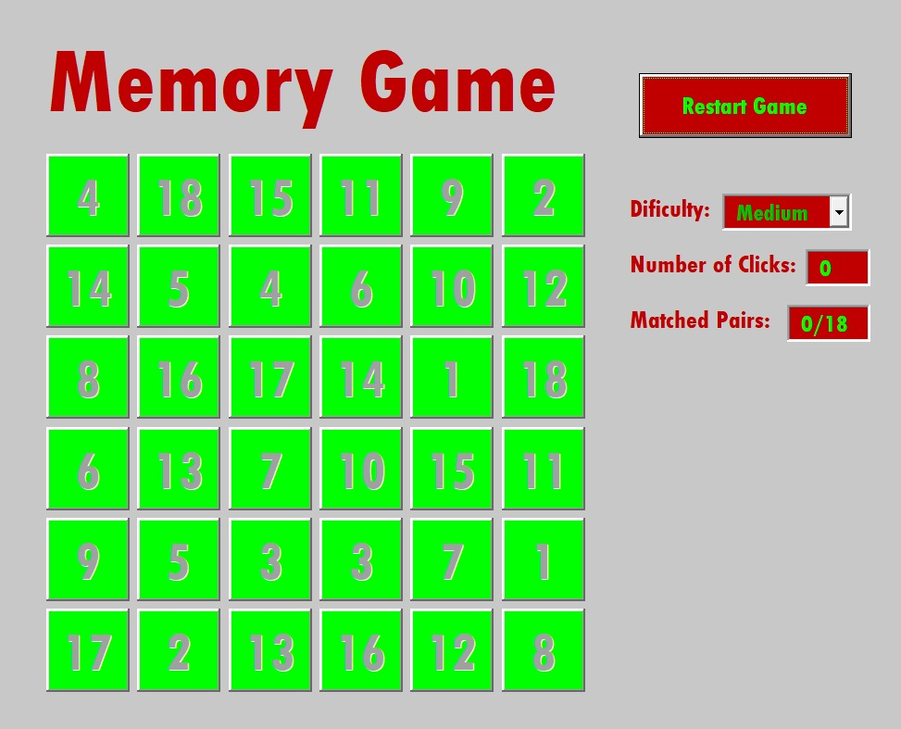
Interface
Start Game Button
Number of Clicks Text Box
Matched Pairs Text Box
Card Buttons
Dificulty Combo Box

Slide 11
05
How it works?

Slide 12
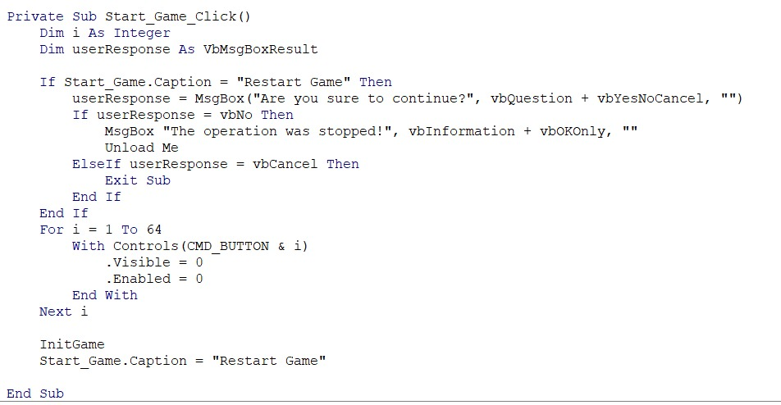


Start Game Button

Slide 13
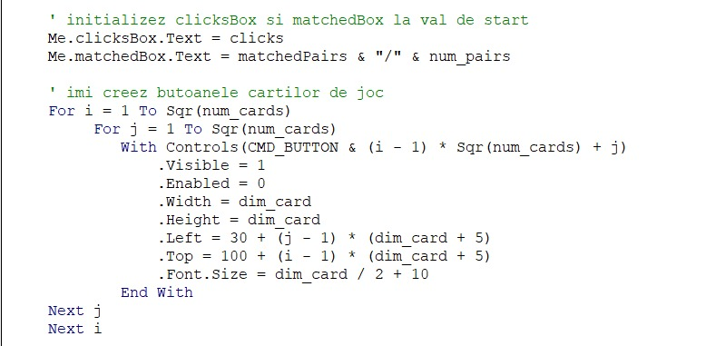
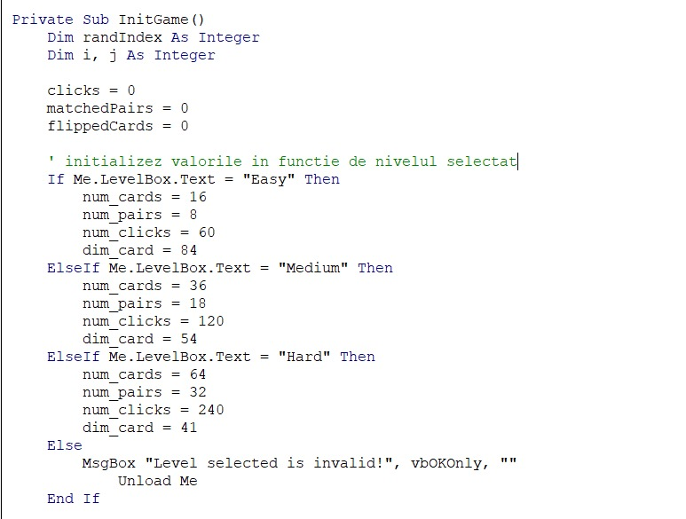
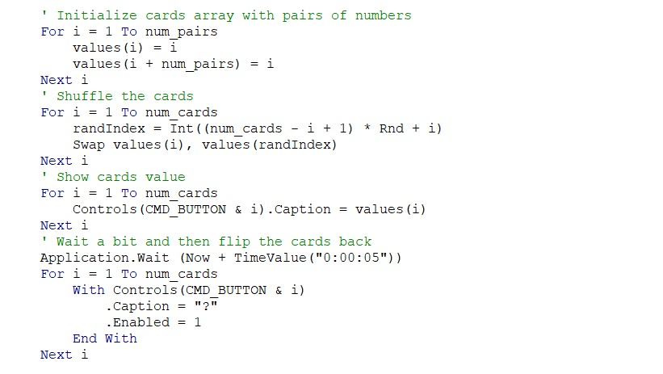
Init Function

Slide 14
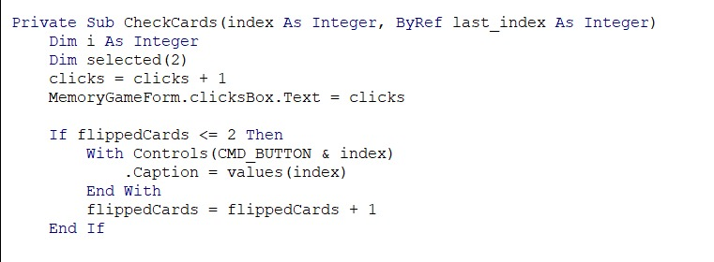
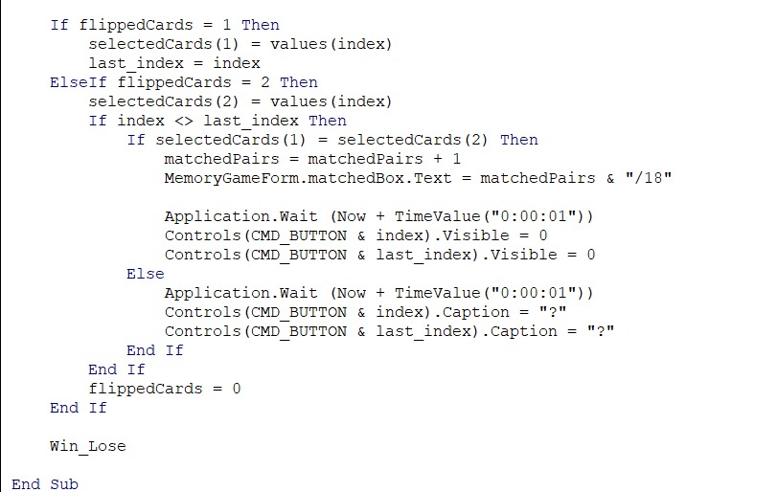
CheckCards

Slide 15
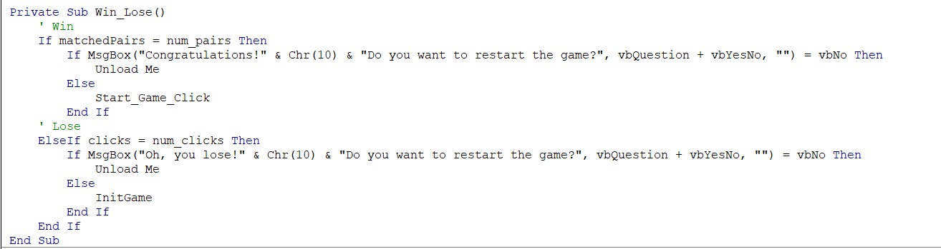
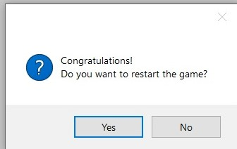
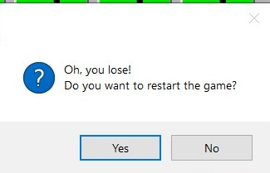
Win/Lose

Slide 16
06
Conclusions

Slide 17
Conclusions
Finally, by going through this project that helps people develop memory, we not only managed to develop our memory during testing, we managed to deepen the knowledge gained during VBA courses.
Finally, by going through this project that helps people develop memory, we not only managed to develop our memory during testing, we managed to deepen the knowledge gained during VBA courses.
This project has developed skills such as teamwork, creativity, logic, etc.
We encountered some problems but there was always someone to help us and answer our questions.

Slide 18
Thanks!

